Slide 1

A female neonate with short bowel syndrome, incompatible with life.
A hard decision making for parents :
- Prolonging life by continue TPN and accept complications and suffering.
- Withdrawal of TPN and accept comfort natural death.
- Prepare for grief and bereavement care
January 25th, 2023
12.00 – 13.30 O’ clock
Karunruk Palliative Care Center
Srinagarind Hospital
Access: ZOOM
Meeting ID: 989 4476 7877
Passcode: 1234

Slide 2
Palliative Care Conference
Thanapon Tangsakul, Fellowship
Karunruk Palliative Care Center
January 25th, 2023

Slide 3
Thai Female Neonate
DOL: 11 days
Residence: Phon Phisai, Nong Khai
Universal coverage
Ward: NICU
Preterm GA 34+6 weeks
Cesarean section due to maternal previous cesarean section
Birth weight: 2425 g, APGAR 2, 7, 8T

Slide 4
Antenatal Care
First ANC at GA 12+1 weeks then regular visits, 9 times
At GA 30+2 weeks, detected polyhydramnios
U/S at GA 31 weeks
  Single fetus cephalic EFW 1867 (P72)
  AFI 23.2 cm
  Dilate bowel 1.5cm, hyperechogenic bowel (suspected matted bowel), wall thickness 0.4 cm, +/-minimal ascites
  Impression: duodenal atresia with suspected meconium peritonitis with polyhydramnios
Obstetrician informed diagnosis
Plan:
  postnatal repairing surgery
  weekly NST
  dexamethasone for lung maturity at GA 32 weeks

Slide 5
11 Days Before Consultation
Presented at provincial hospital
Decreased fetal activity with uterine contraction every 10-20 min
No fever or dysuria
NST: category II (minimal variability, no DC, no AC)
IUR ---> NST category I, then referred

Slide 6
At SNH
Cough test positive
TAS: EFW 3124 g, AFI 15.5 cm
NST: no FHR drop
Next day, labor pain ---> C/S due to previous C/S
Child was born after MR 2 hr
Bloody amniotic fluid, placenta examination did not show abruptio placenta
Inactive and atonia, not cry, HR < 100 bpm
PPV 3 cycles
APGAR 2, 7, 8T ---> severe birth asphyxia
Admitted NICU

Slide 7
Hypoxic Ischemic Encephalopathy
Cord ABG: pH 7.27, pCO2 41, pO2 315, BE-7.5, HCO3 18.8, lactate 66 ---> metabolic acidosis
Oliguria and hypotension period ---> start dopamine 3 mcg/kg/hr
Subtle seizure (chewing) at 2.4 hr after birth, 5-10 seconds, self-limited
U/S brain bedside: no ICH
EEG shown encephalopathy pattern
SARNAT score ---> moderate HIE
Diagnosis: moderate HIE with cardiac involvement

Slide 8
Hypoxic Ischemic Encephalopathy
Management:
  Therapeutic hypothermia
  Phenobarbital 20 MKDose then 3 MKDay
F/U MRI brain (4 days after birth)
  Multiple ill-defined lesion involving subcortical white matter of right frontal lobe and deep white matter of bilateral fronto-parieto-temporal lobes
  Suggested acute to subacute HIE
Informed parents about diagnosis and prognosis

Slide 9
Hypovolemic Shock
At birth: bloody AF, retain OG tube ---> blood 30 ml, not active bleeding
Hct 35%
1 hr after birth: hypotension (BP 35/19 mmHg, MAP 26 mmHg)
Work-up for cause of neonatal anemia: negative all test
Diagnosis: hypovolemic shock
Volume resuscitation with NSS 10 ml/kg in 15 min
PRC transfusion

Slide 10
Polyhydramnios
U/S at GA 31 weeks: polyhydramnios, bowel dilate 1.5 cm, hyperechogenic bowel ---> suspected duodenal atresia
After birth, GI hemorrhage
Abdomen film: no bowel dilate, normal gas pattern, calcified lesion at RLQ abdomen
Consult radiologist, suggested walled-off perforated intrauterine midgut volvulus due to intestinal malrotation

Slide 11
Polyhydramnios
Consulted pediatric surgeon: unstable clinical conditions --- operation was held
Start TPN at DOL 2
Informed parents about diagnosis, role, risk and benefit of operation:
  Bowel resection and anastomosis
  Risk: bleeding, short bowel syndrome, TPN dependence
Parents accepted risk and benefit

Slide 12
Midgut Volvulus & Duodenal Atresia
Operation was performed at DOL 7
Intraoperative finding: obstruction of 3rd part duodenum, midgut volvulus, severe adhesion at liver, ileum, abdominal wall and gallbladder
Small bowel resection with duodenoileostomy and appendectomy
Post-operation diagnosis: small bowel volvulus with meconium peritonitis and duodenal atresia
Residual small bowel length: 1 cm of ileum
IC valve: preserved

Slide 13
Post-operation
Anemia of acute blood loss: blood loss 61 ml/kg, Hct 30%
Sepsis at POD2: anastomosis leakage ---> vancomycin and cefotaxime
Pediatrician and surgeon shared situation and anticipatory events: TPN dependence, risk of liver failure, infection, electrolyte imbalance
Parents understood, requested withholding further invasive procedures

Slide 14
PC team was consulted for best supportive care
What approach should we focus on?

Slide 15
PC Attending: DOL 11
GA: Active, BW 2980 g
on HHHFNC 1 LPM FiO4 0.28
no flaring alar nasi, no retraction
V/S: BP 72/46 MAP 64 PR 166 RR 62 SpO2 92
Skin: Pink, good skin turgor
Head: AF 2x3 cm, PF FT
Eye: No discharge, anicteric sclera, no subconjunctival hemorrhage
Ear, nose, mouth, palate: no low set ear, no choanal atresia, normal lip and palate, no tongue tie
Neck, thorax: Normal form

Slide 16
PC Attending: DOL 11
Lungs: Clear, equal breath sound
Heart: Normal s1s2, no murmur
Abdomen: Soft, impalpable liver and spleen, RUQ surgical wound, minimal discharge at Penrose drain site
Sucking/Rooting/Grasp/Glabellar tapping reflex: positive
Moro reflex: weak

Slide 17
Investigation
CBC: Hb 10.2 g/dl, Hct 29.6%, Plt 136,000 cell/mcl WBC 11,870 cell/mcl PMN 75% LY 3% MO 5% Band 13%
BUN 17.1 mg/dl, Cr 0.54 mg/dl, Na 139 mEq/L, K 5.1 mEq/L, HCO3 18.9 mEq/L, Cl 109 mEq/L
Ca 7.8 mg/dl, PO 3.6 mg/dl, Mg 1.3 mg/dl

Slide 18
Investigation
LFT (DOL 7): TB 6.4 mg/dl, DB 1.3 mg/dl, PT 3.6 g/dl, Alb 2.3 g/dl, Glb 1.3 g/dl, AST 40 U/L, ALT 19 U/L, ALP 113 U/L
Coagulogram (DOL 6): PT 13.5 sec, INR 1.26, PTT 29.3 sec
Hemoculture of central line: NG
Tracheal secretion culture: Pseudomonas aeruginosa, Klebsiella pneumoniae MDR --- colonization

Slide 19
Current Medication
Vancomycin (23 MKDay) iv drip in 8 hr
Cefotaxime (50 MKDose) iv q 12 hr
Fentanyl 2.5 mcg iv prn q 6 hr
on TPN
NSS replace OG 0.5 ml/hr x 8 hr
off phenobarb at DOL 7

Slide 20
Suffering Symptoms
Pain: NIPS = 1/7 -> no pain, fentanyl was not used
Dyspnea: on HHHFNC RR 62 SpO2 92, no nasal flaring or retraction -> no dyspnea

Slide 21
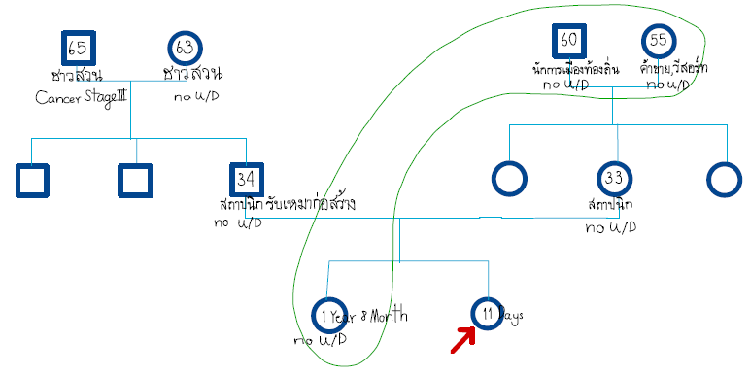
Deny genetic disease in family
No financial problems

Slide 22
Parent’s Perception: Pregnancy
Wanted child, planned to have 2 children
Regular ANC visit, good taking care
Be informed about child's abnormalities at GA 31 week
Felt shocking and stunning, disappointed
Planed to delivered the child at near-home hospital

Slide 23
Parent’s Perception: Illness
Parents known well about patient's conditions
  birth asphyxia
  duodenal atresia, volvulus
  short bowel syndrome
May need life-long TPN
Be at risk of liver disease and catheter related infection
Treatment and complications causes significant suffering to patient
Searching on alternative treatment: lengthening bowel surgery, intestinal transplantation

Slide 24
Emotional Issue
Experience on loss: patient's great-grandmother died at old age --- it is acceptable
Current feeling:
  grief “ครั้งนี้ยากที่จะทำใจยอมรับ”
  disappointed "ทำไมต้องเกิดกับครอบครัวเรา ตอนท้องก็ดูแลตัวเองอย่างดี“
Copping: support in family ---> "พยายามทำใจ แต่ถ้าวันนั้นมาถึงจริงๆก็ไม่รู้จะทำใจได้ไหม"
Wanted help: psychiatrist appointment

Slide 25
Problem List
Late preterm newborn
Severe birth asphyxia with moderate HIE S/P therapeutic hypothermia
Duodenal atresia and small bowel volvulus with meconium peritonitis S/P small bowel resection with duodenoileostomy and appendectomy
Short bowel syndrome; on TPN
Anastomosis leakage with sepsis
Anticipatory grief
Risk of pathologic grief (in case of patient die)

Slide 26
Neonatal Hypoxic Ischemic Encephalopathy
Brain damage due to low oxygenated cerebral blood flow
Maternal, fetal, procedural factors
Estimated prevalence: 1.6 per 1,000 live births
Classification: Sarnat scale; mild, moderate, severe ---> prognosis
Treatment: therapeutic hypothermia
Outcome: wide range, neuropsychological, behavioral, living

Slide 27
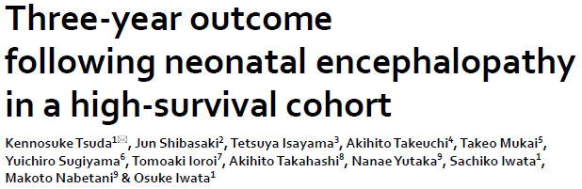
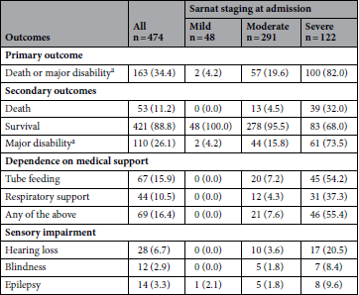
Retrospective observational study
NICU, Japan
HIE neonates N = 474, received therapeutic hypothermia; registered 2012 to 2016
K Tsuda. et al. Nature. 2022.

Slide 28
Short Bowel Syndrome
Reduction of small bowel length
Resulting in malabsorption, malnutrition
Causes: congenital or acquired
Most common: NEC, gastroschisis, atresia
Required parenteral nutrition (at least a period), about 50% achieved enteral nutrition goal
Factors: etiology, residual bowel length and type, anastomosis type, IC valve
Mortality: 2.9 – 27%
Causes of death: liver failure, infection
Bering J et al. Am J Gastroenterol. 2022;117(6):876–83.
Cernet E et al. Frontline Gastroenterol. 2020;614–21.
Cohran VC et al. Nature. 2017; doi:10.1038/pr.2016.265

Slide 29
Family Meeting (DOL 19 & 21)
Participant: pediatrician, surgeon, parents
Diagnosis: duodenal atresia, midgut volvulus, short bowel syndrome, sepsis
Choice of care
1) Go on life-long TPN, surgery in the future and full resuscitation (not certain survival time)
2) Withholding some invasive treatment , continuing TPN until medically worst situation (not certain survival time)
3) Withdrawal of TPN and withholding invasive procedures, accept natural death (days to month after withdrawal)

Slide 30
Family Meeting (DOL 19 & 21)
Surgical intervention (opinion of the experts)
  Bowel lengthening: not possible due to only 1 cm of ileum left
Bowel transplantation
  Never done in Thailand
  Low success rate
  High risk of graft rejection
Conclusion
  Chosen choice of care: not 1), may be 2) or 3)
  No further surgery
  No ETT, no CPR
  Accept peripheral inotropic drugs, antibiotic and blood components

Slide 31
What do you think about PN in this patient?
“Parenteral Nutrition”

Slide 32
PC Team’s Prognostication
Survival: infection, IFALD
Quality of Life:
  HIE: neurodevelopment, disabilities
  SBS: PN dependence, hospitalization, re-operation, catheter placement
Modifying measures: PN, ±surgery, antibiotic, enteral advancement, developmental rehabilitation

Slide 33
PC Team’s Prognostication
Net effect
Gain: prolonging life (may be), some improvement of development
Loss: hospital-bound (patient and parents), procedural suffering, changing of family dynamic, family stress (patient, parents, sibling, grandparents)

Slide 34
Prognosis
Aims: prolonging life, improving development
Do modifying measures
Best scenario: long lasting admission for PN, hope for new technology or surgical technique
Worst scenario: hospital acquired infection, IFALD, death
Most possible scenario: PN dependence, IFALD, infection, lack of venous access, death ---> limited life expectancy

Slide 35
Biomedical Ethics: Scenario
I. Continuing PN as long as possible
II. Continuing PN as long as medical appropriate, no invasive procedure for site accessing
III. Withdrawal of PN

Slide 36
Scenario I
Ethics | Issues
Beneficence | Prolonged life and time for family (for a period)
Maleficence | Patient’s physical suffering Parent’s psychospiritual suffering Change whole life of all participants
Autonomy | Patient cannot do, parents do in behalf of her
Justice | Can be accessible by right Right of life preserving Burden on national finance
Increase survival time, decrease QoL

Slide 37
Scenario II
Ethics | Issues
Beneficence | Prolonged life and time for family (for a period)
Maleficence | Patient’s physical suffering (lesser than scenario I) Parent’s psychospiritual suffering Change whole life of all participants
Autonomy | Patient cannot do, parents do in behalf of her
Justice | Can be accessible by right Right of life preserving Burden on national finance (lesser than scenario I)
Increase survival time, decrease QoL

Slide 38
Scenario III
Ethics | Issues
Beneficence | Lesser patient’s physical suffering ---> Lesser parent’s suffering Less burden on national finance
Maleficence | Shorter life expectancy and family time ±Parent’s psychospiritual suffering -- ambivalent feeling, guilt
Autonomy | Patient cannot do, parents do in behalf of her
Justice | Principle of dual effect Respect on nature of life; death is a part of life
Decrease survival time, Increase QoL

Slide 39
Family Meeting 2 (DOL 34)
Participants: Pediatrician, PC team, Parents
Recapping situations
Sharing prognosis, choices of care and possible outcome
Parent perceived limitation of life expectancy, life incompatibility and uncertainty of prognosis
Parent’s concern:
  Quality of life; suffering from treatment
  Quality of life is more important than the limited survival
  Grandparent’s feeling and adaptation

Slide 40
Family Meeting 2: Conclusion
Preference: no more suffering from treatment, spend time together
Withdrawal of PN
Advance Care Plan
Goal of care: comfort care, allow natural death
Proxy: patient's father and mother
Place of care and death: hospital --- PC ward
Plan for further treatment: no surgery, no RRT, no ETT, no CPR, as least as possible investigation

Slide 41
Bereavement Care
Anticipatory grief
Risk of pathologic grief
  Death of child
  Ambivalent feeling and guilt
Special team for spiritual and bereavement care: “ทีมดูแลใจ” (PC nurse and social worker)
Internal strength
Plan for future

Slide 42
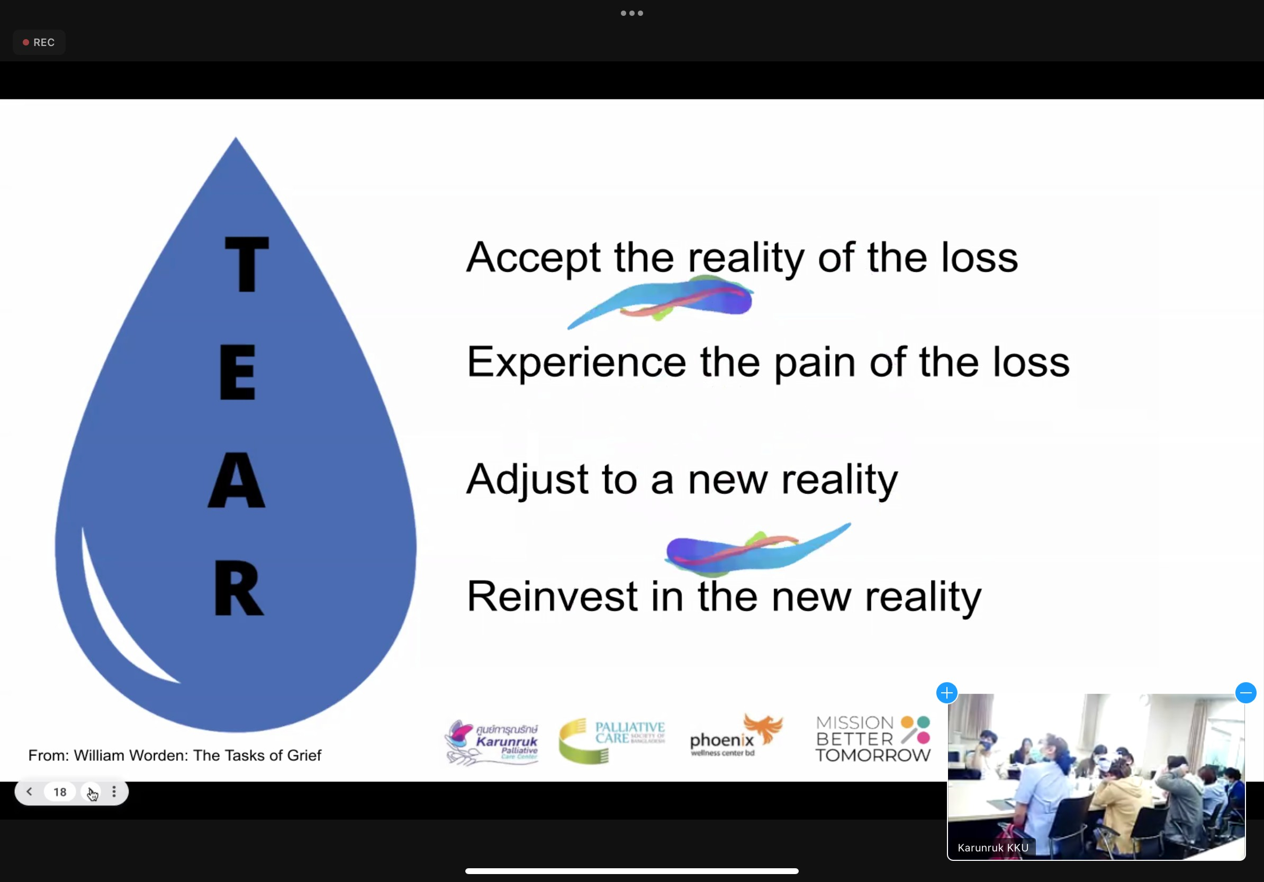

Slide 43
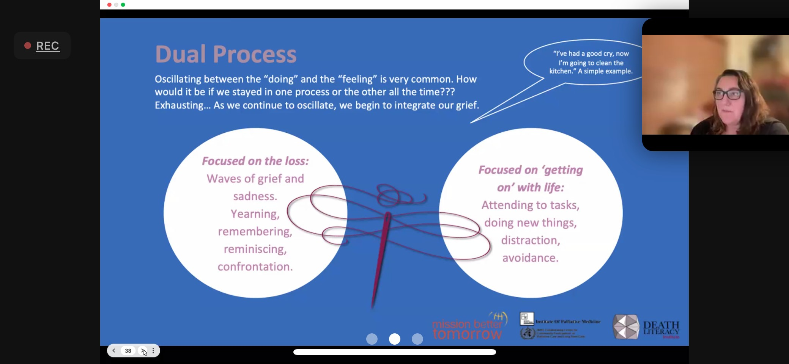

Slide 44
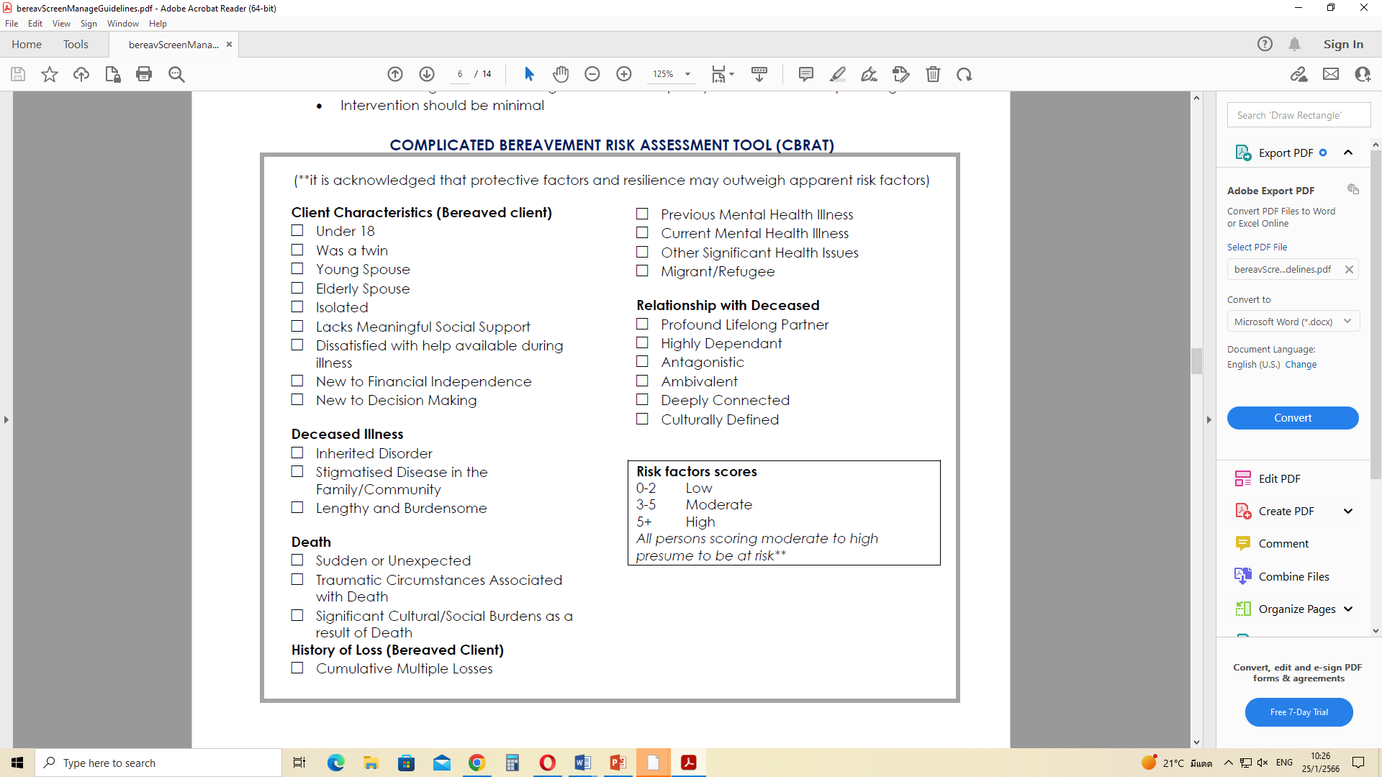

Slide 45
Progression: DOL39
Clinical situation was stable, looked comfort
Feeding intolerance
Loss of central venous catheter
PN was given via peripheral line
Fentanyl was not used
Family confirmed ACP
Plan: Transfer to PC ward

Slide 46
Anticipatory Symptoms
  Dyspnea: morphine po/iv
Agitation
  Hypoglycemia: parenteral glucose, sugar solution oral feeding as tolerate
  Pain: morphine po/iv
  Other discomfort: finding out causes and correct the possible ones

Slide 47
Short Bowel Syndrome of Infancy: A Brief Review
Thanapon Tangsakul, Fellowship
Karunruk Palliative Care Center
January 25th, 2023

Slide 48
Short Bowel Syndrome
Reduction of small bowel length
  insufficient absorptive surface area
  malabsorptive state
  Be at risk of intestinal failure
Population-based estimation: 22.1 per 1000 NICU admissions

Slide 49
Intestinal Failure
Inadequate intestinal absorption of water electrolyte and nutrients
Resulting in …..
  dehydration
  growth retardation
  parenteral nutrition dependence (at least 90 days after event)

Slide 50
Etiology
Congenital and acquired causes
NEC 43.9 – 16%
Gastroschisis 23 - 16%
Intestinal atresia 24 - 10%
Volvulus 18.2 – 9%
Hirschprungs disease 13 -4%
Cohran VC et al. Nature. 2017; doi:10.1038/pr.2016.265

Slide 51
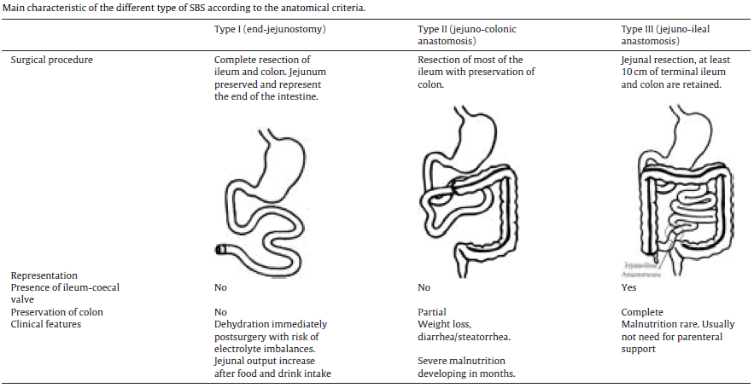
Anatomical Classification
Massironi S et al. Digestive and Liver Disease 52 (2020) 253–261.

Slide 52
Aims of Treatment
Promote growth and development
Stimulating intestinal adaptation
Enteral autonomy (free from PN and adequate growth and development)
Preventing complications
Multidisciplinary Approach

Slide 53
Mortality
Causes of death
  IF-associated liver disease (IFALD)
  Hepatic failure
  Sepsis
  Lack of venous access
Risk factors
  length of residual bowel
  loss of IC valve
  Sepsis
  IFALD development

Slide 54
Prognostic Factors: Enteral Autonomy
Etiology:
    NEC is better than others (chance for EA in 4 year; 65% vs 29%)
Residual bowel type
  Ileum has better adaptability than jejunum
Residual small bowel length:
  > 50 cm: 88% in 1 year, 96% in 2 years
  < 50 cm: 23% in 1 year, 38% in 2 years, 71% in 57 months

Slide 55
Prognostic Factors: Enteral Autonomy
Classification: type I is poorer than others
Primary enterocolonic anastomosis has greater chance
Presence of IC valve: prevent retrograde migration of colonic bacteria, slow transit time

Slide 56
Treatment: Surgical
Objectives:
  preserving maximal small bowel length
  re-establishing functional bowel integrity (ostomy closure)
Autologous intestinal reconstructive surgery:
  Longitudinal intestinal lengthening and Tailoring (LILT)
  Serial Transverse Enteroplasty (STEP)
  No survival difference between LILT and STEP

Slide 57
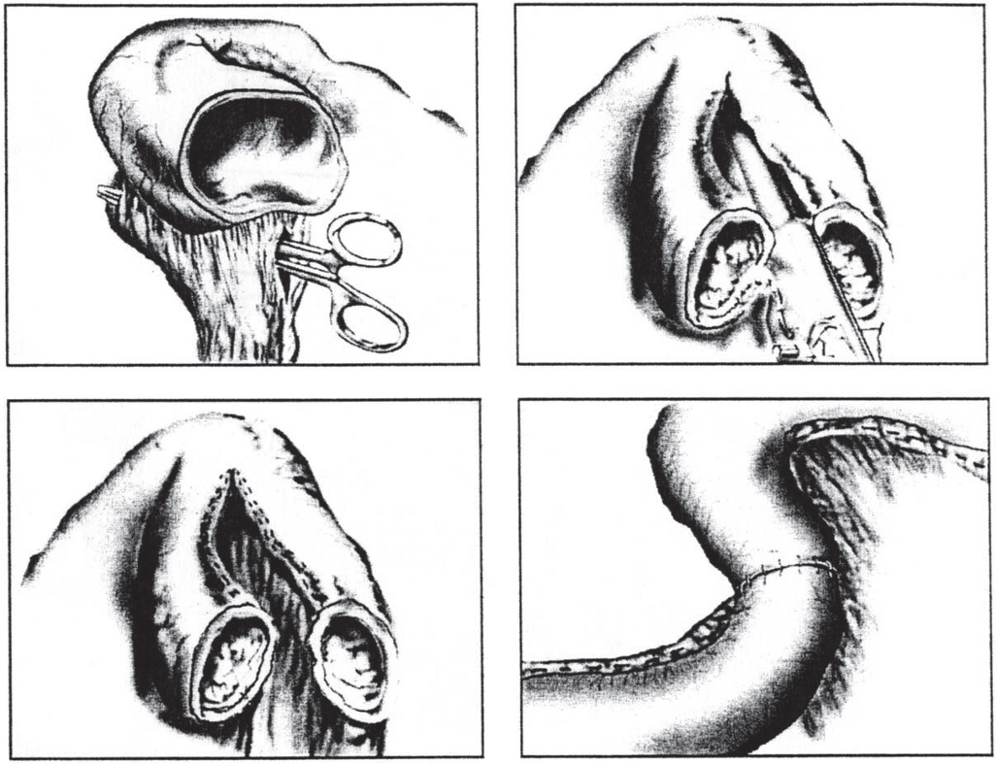
Longitudinal Intestinal Lengthening Tailoring
Cohran VC et al. Nature. 2017; doi:10.1038/pr.2016.265

Slide 58
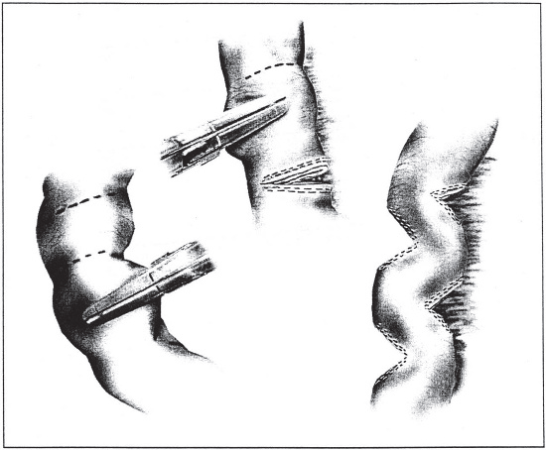
Serial Transverse Enteroplasty
Cohran VC et al. Nature. 2017; doi:10.1038/pr.2016.265

Slide 59
Treatment: Surgery
Intestinal transplantation:
  unable to attain EA
  unsuccessful bowel lengthening surgery
  develop serious complications

Slide 60
Treatment: Nutrition
Fluid, electrolyte and nutrients
Parenteral nutrition
  In early phase after surgery
  May be prolonged for long time
Enteral nutrition is preferred, initiate as soon as possible
  Breast milk is prefer to alternative formula
  Alternative formula: no consensus on the best
  Individualized regimen: clinically indicated

Slide 61
Treatment: Medication
On going development
Teduglutide
  GLP-2 analogue
  promoting villous growth
  Trend toward reduction of PN requirement
  Loss effect when stopped
Epithelial growth factor
Insulin like growth factor-1

Slide 62
Disease Complications
Alteration of body composition:
  sarcopenic obesity
Low bone mineral density:
  reduce calcium uptake and low vitamin D level
Oxalate nephrolithiasis
  increase oxalate absorption by LB ---> excretion in urine ---> oxalate stone

Slide 63
Disease Complications
Gastric acid hypersecretion
  treated by PPIs, H2 blockers
Small Intestinal/Bowel Bacterial Overgrowth
  Factors: length of residual SB, ICV presence
  Treatable: treat underlying conditions, correct nutritional deficiency and antibiotic
Diarrhea: 2 possible causes
  Bile irritation on large bowel
  2) Rapid content transition

Slide 64
Complication of Treatment
Surgery-related conditions
  Gut obstruction
  Anastomotic ulcer: overt bleeding, chronic IDA
  Stomal complications: prolapse, retraction, obstruction, excoriation of peristomal skin, bowel ischemia
  Electrolyte imbalance: high output jejunostomy
Catheter-related conditions: prolong C-line placement
  Mechanical: thrombosis, embolism
  Infection: BSI (including CRBSI)
PN-related
  Intestinal failure-associated liver disease (IFALD)
  Copper and maganese accumulation (in cholestasis)

Slide 65
Bloodstream Infection
Catheter-related (CRBSI): SBS is 0.2% of admission but accounted for 20% of BSI
Non-CRBSI: 43%
Pathogen: Escherichia coli and enterococci group
Risks: central venous catheter, leaky gut mucosal barrier (bacterial translocation), surgical complications

Slide 66
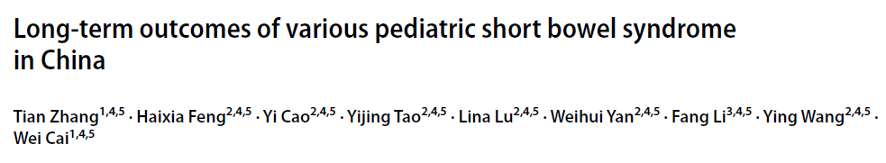
Retrospective cohort study
China, N = 157, Oct 1988 to July 2019
Causes of SBS: NEC, intestinal atresia, volvulus
Median time to follow-up: 36 months
CRBI: 21.1% in neonate and 25.6% in infant and children onset
PN duration is associated to CRBI,
  Duration 90 days vs 60-89 days vs 42-59 days: 30.6% vs 12.8% vs 12.1% (p = 0.0.25, R 0.236, P of R = 0.003)
Statistically significant difference in chance of CRBI among anatomical type:
  Type I > Type III > type II; 30.0% vs 16.7% vs 5.3% p = 0.032
Zhang T et al. Pediatric Surgery International (2021) 37:495–502.

Slide 67
Central Venous Thrombosis
Long-time dependence of PN
Resulting in lack of venous access
Ethanol locks:
  association of preventing CRBSI and CVC replacement
  limited evidence in BW < 5 kg

Slide 68
IFALD
Intestinal Failure Associated Liver Disease
Histopathology: steatosis, cirrhosis
Cholestatic liver disease:
  Conjugated bilirubin ≥ 2 mg/dl
  Causes: lipid in PN, sepsis, lack of enteral feeding
  DDx: biliary atresia (need surgical intervention)
Associated to soybean lipid in lipid formula
Intervention:
  Lipid reduction
  Alteration formula
  Advancement of enteral nutrition

Slide 69
Effect on life
Patient
PN dependence
Operation(s) and catheters
Hospitalization: long-time, frequent blood test and imaging
Shortening of life: disease or treatments complication
Growth and development
Carers
higher prevalence of anxiety and depression in SBS’s carers than the similar population
Effect on Quality of Life

Slide 70
What I Learned …..
Pediatric Palliative Care: category, prognosis
Short bowel syndrome: natural history and treatment
Multi-dimension assessment: biomedical and ethical

Slide 71
Reference
Bering J, Dibaise JK. Short Bowel Syndrome in An Infant. Am J Gastroenterol. 2022;117(6):876–83.
Cernat E, Corlett C, Iglesias N, Onyeador N, Steele J, Batra A. Short bowel syndrome in infancy: Recent advances and practical management. Frontline Gastroenterol. 2020;614–21.
Cohran VC, Prozialeck JD, Cole CR. Redefining short bowel syndrome in the 21st century. Pediatr Res. 2017;81(4):540–9.
Massironi S, Cavalcoli F, Rausa E, Invernizzi P, Braga M, Vecchi M. Understanding short bowel syndrome: Current status and future perspectives. Dig Liver Dis. 2020;52(3):253–61.

